Slide 1
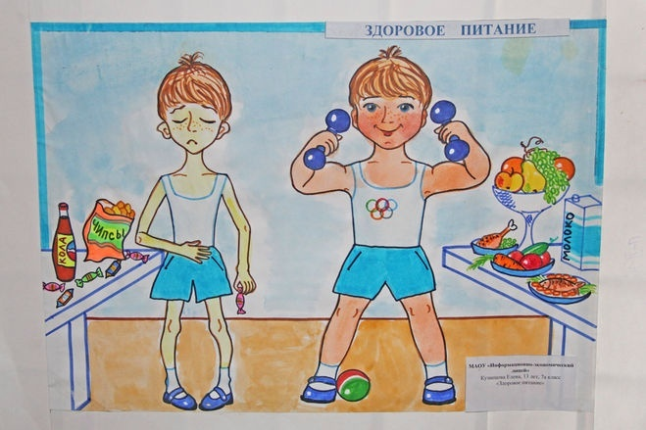
Master-class: “Healthy lifestyle” Teacher: Murzayeva Z.S April, 23, 2018.
The Ministry of education and science of Dagestan Republic
Municipal public educational institution
«Buglen School in honor of Sh.I.Shikhsaidov»
e- mail: :shkola.buglen@mail.ru

Slide 2
English proverbs
“An apple a day keeps a doctor away”,
“Good health is above wealth”,
“A sound mind is a sound body”
Доброе здоровье дороже богатства
В здоровом теле здоровый дух
Яблоко в день, и доктор не нужен

Slide 3
Healthy way unhealthy way

Slide 4
Translate into English
Лекарство, наркотик,
Достаточно
Трапеза ,еда
Вред
Болезненно полный
Почти
Быстрый
Дымить, курить
Еда быстрого приготовления
Неполноценная еда

Slide 5
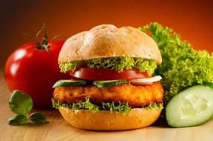
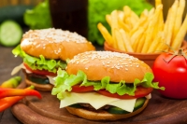
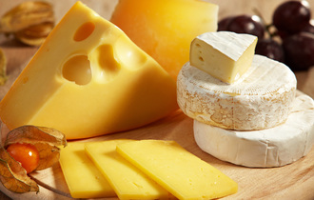
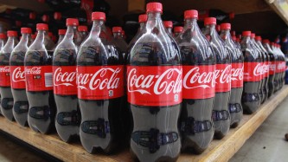
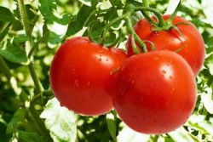
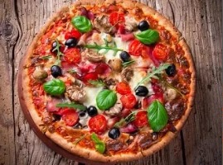
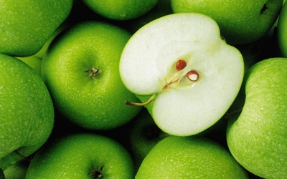
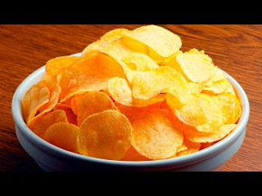
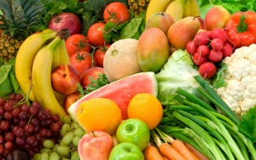
speaking
Tea, milk, hamburger, chips, coke, cake, cheese, tomato, pizza, apple, wine, Vegetables, fruits.

Slide 6
listening

Slide 7
Game “Guess!”

Slide 8
Use the suffixes ful,less, ing , ly, tion, ous and prefixes un, dis to form new words:
home, begin, power, pleasant, friend, harm, operate, danger, agree, real, inform.

Slide 9
Word- formation with the suffixes er, or
Teacher,
Doctor
Read
Write
Eat
Wait
Train
Run
Swim
Play

Slide 10
It is the time to check your knowledge

Slide 11
Home work
Do exercise 6 on page 88 (reading the text in the completed vocabulary, followed by testing. This is format of the GSE. In the next lesson, we will review the reading section of variant 4

Slide 12
The theme of the lesson
Select the extra word on each line
Ann, Tom, I, Mary
Lemon, choose, orange, apple
Healthy, beautiful, wonderful, tasteful
Endangered, extinct, living.

